Slide 1


Project Title : Continues Carbon Fiber 3D printing. Sparkle ID:SP21C001235
Team Members: Rahul Autade
Nachiket Joshi
2021
sparkle.kpit.com

Slide 2
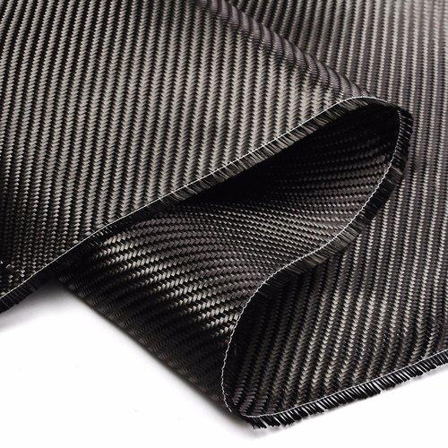
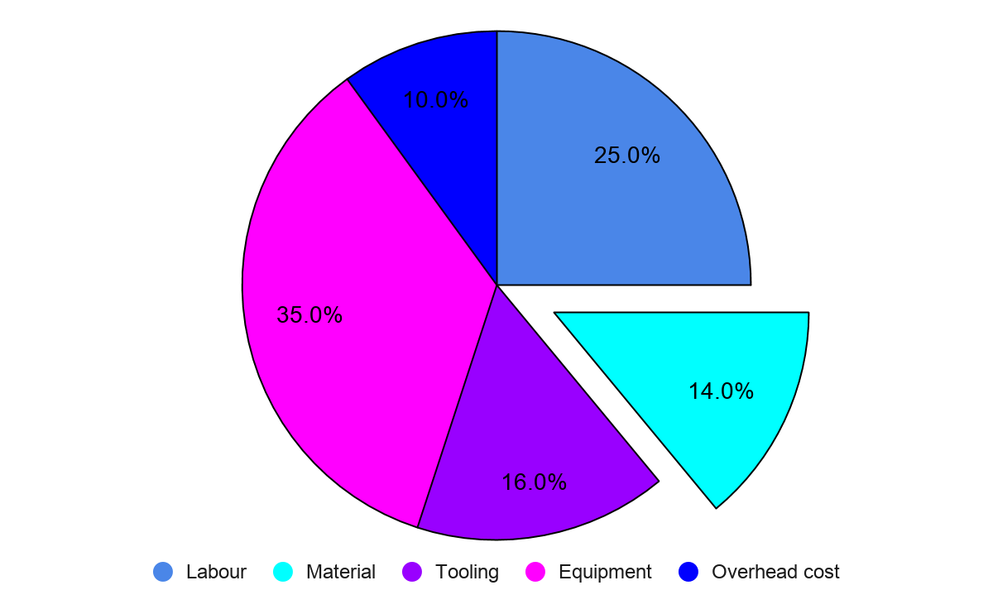
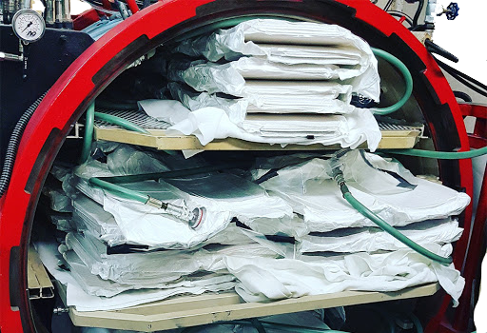
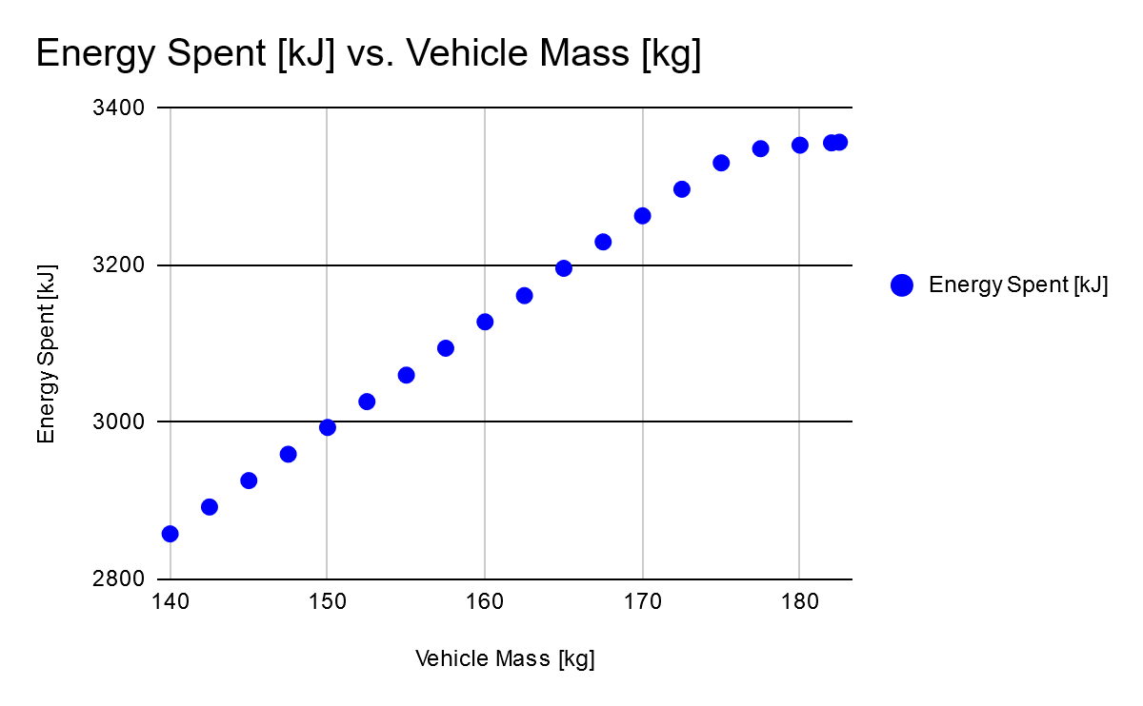
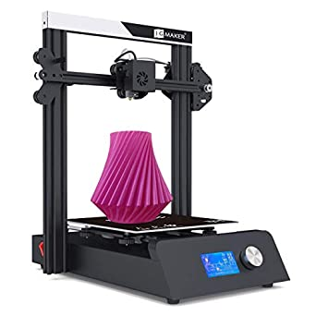

Problem Statement:
Potential
Problem
12% Weight Reduction.
1.65 MT of CO2 Reduction Per Car
=10 X Specific Strength Steel
Lap Time simulation results
3356
6.8% less energy spent
3128

Slide 3
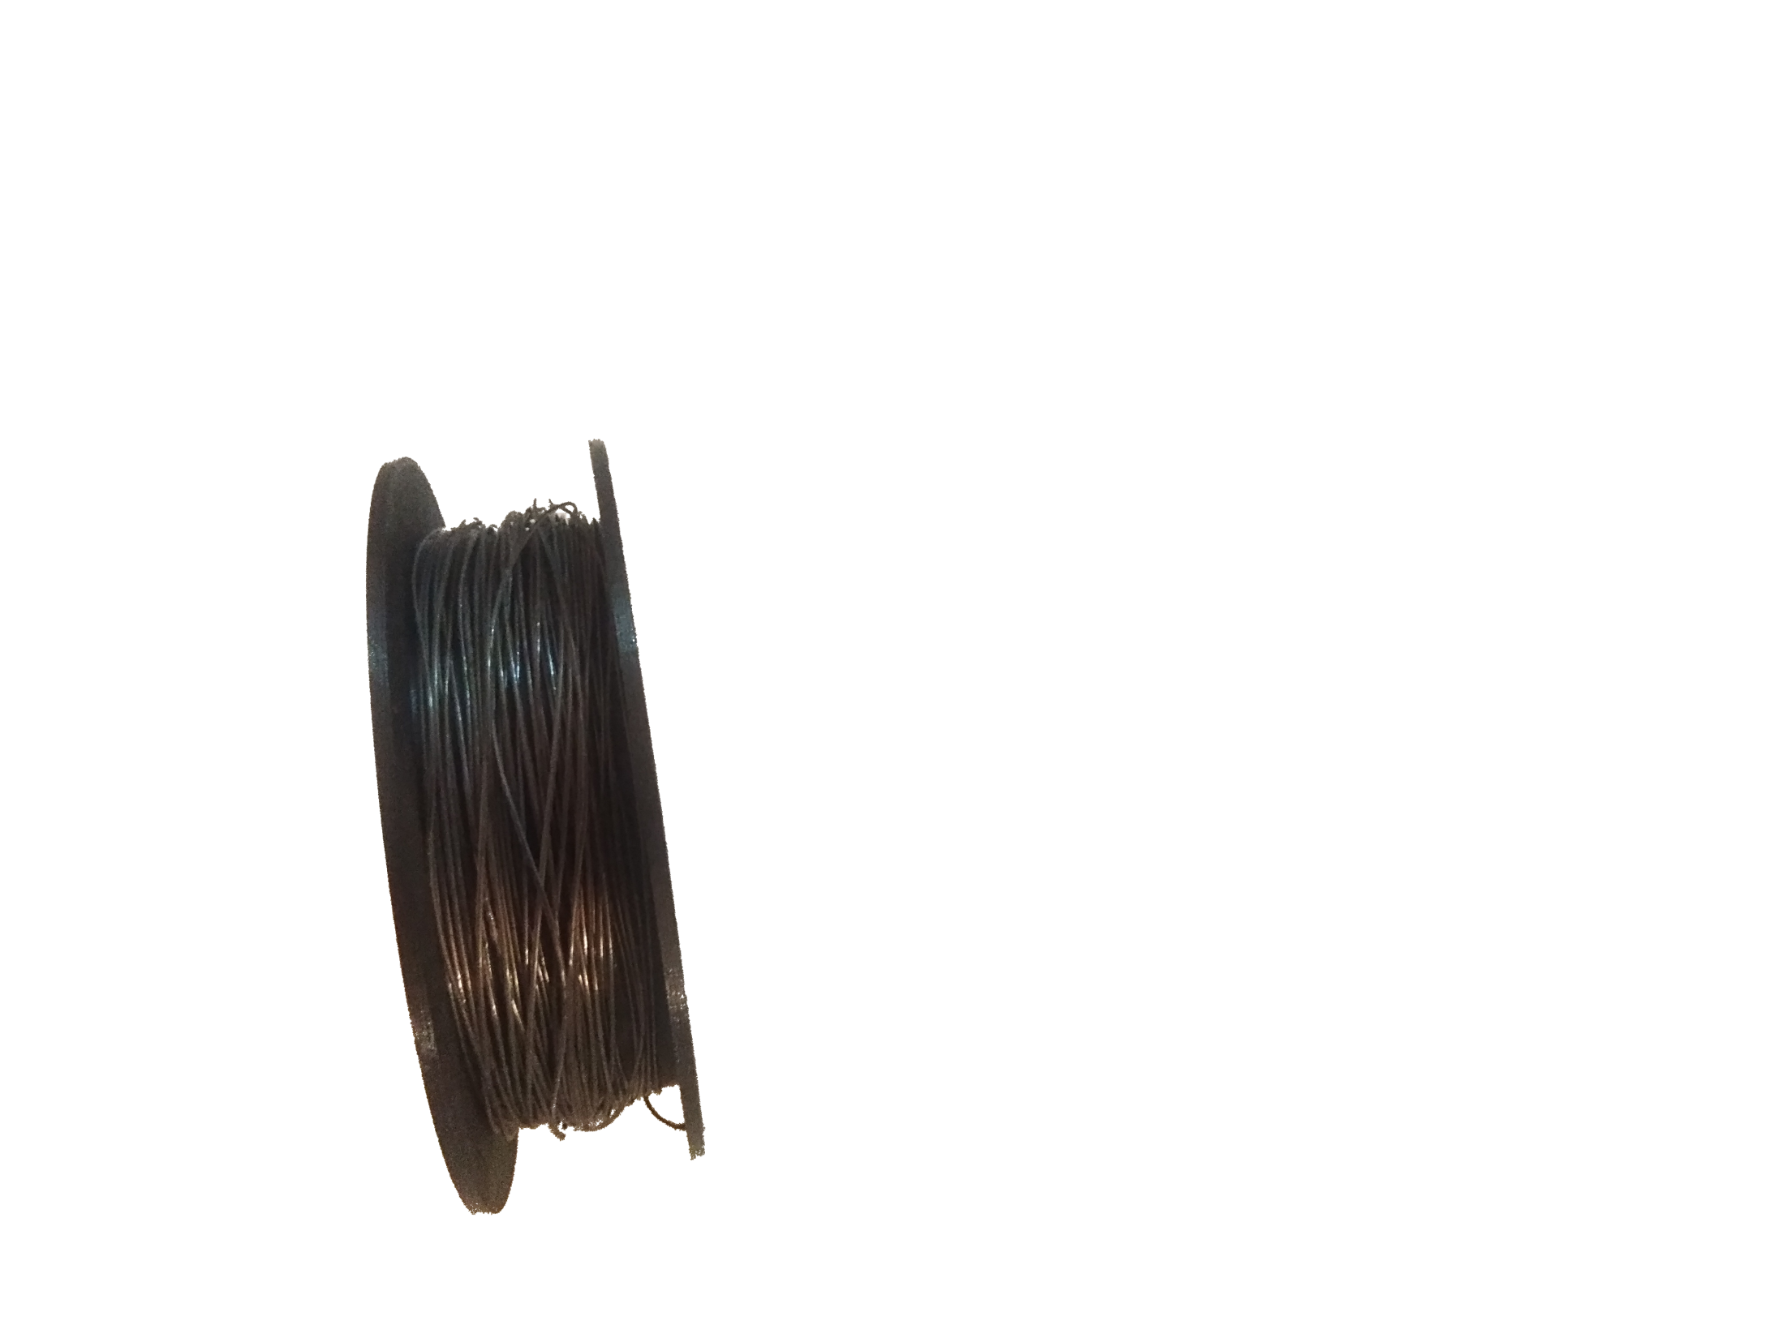
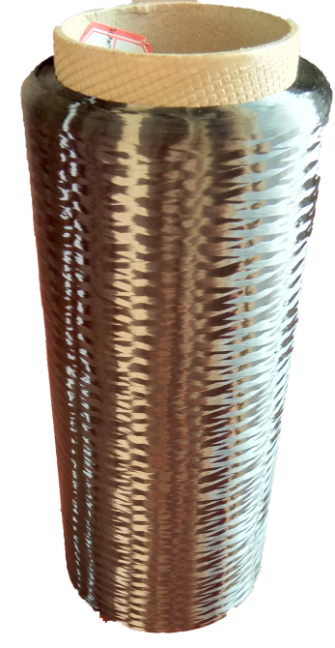
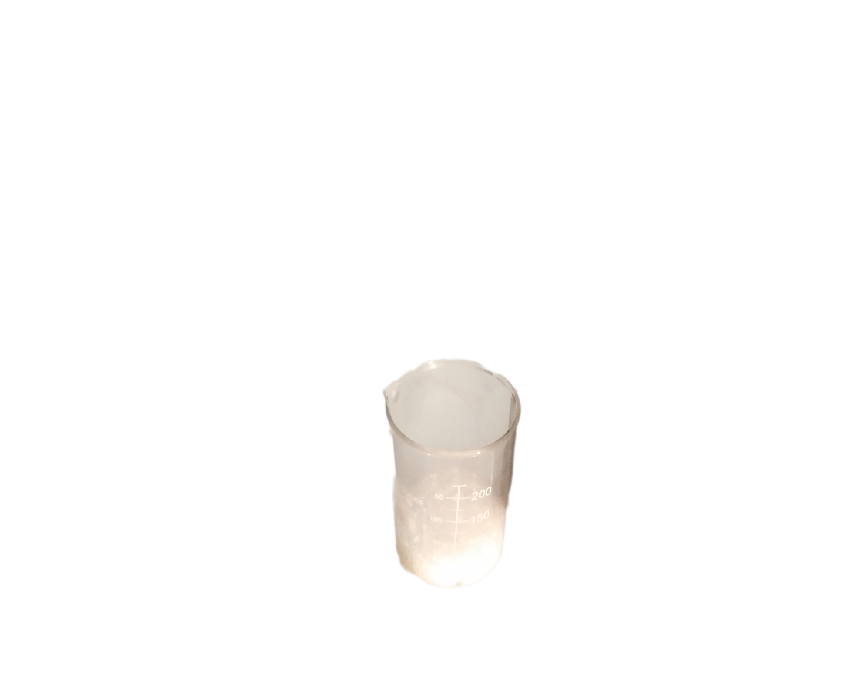
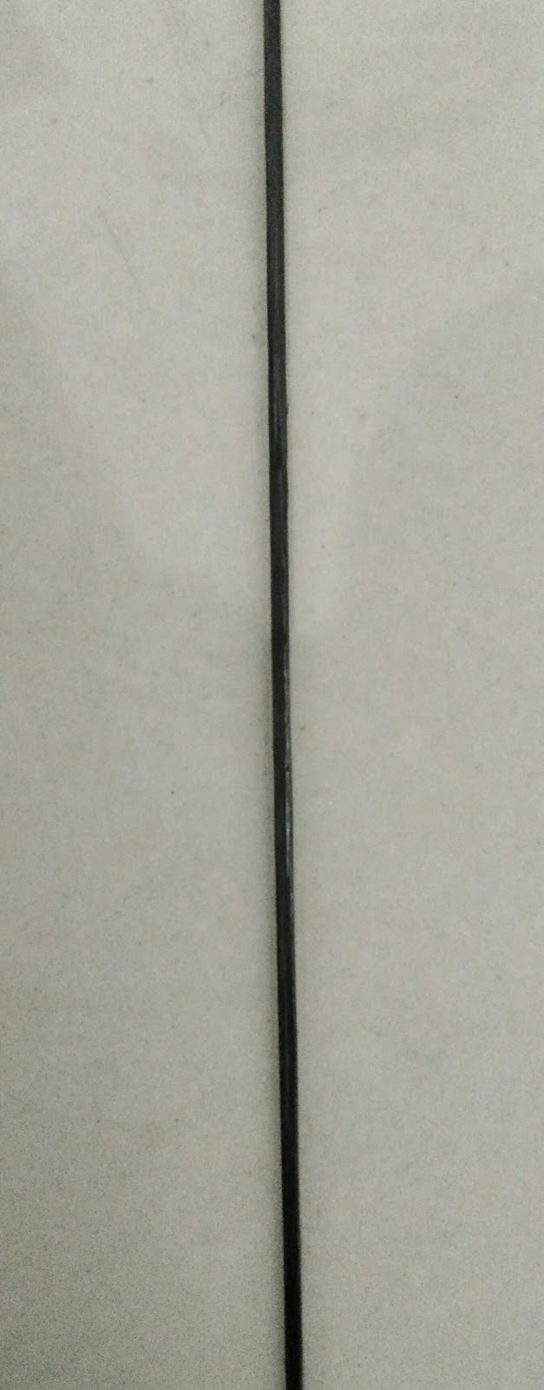
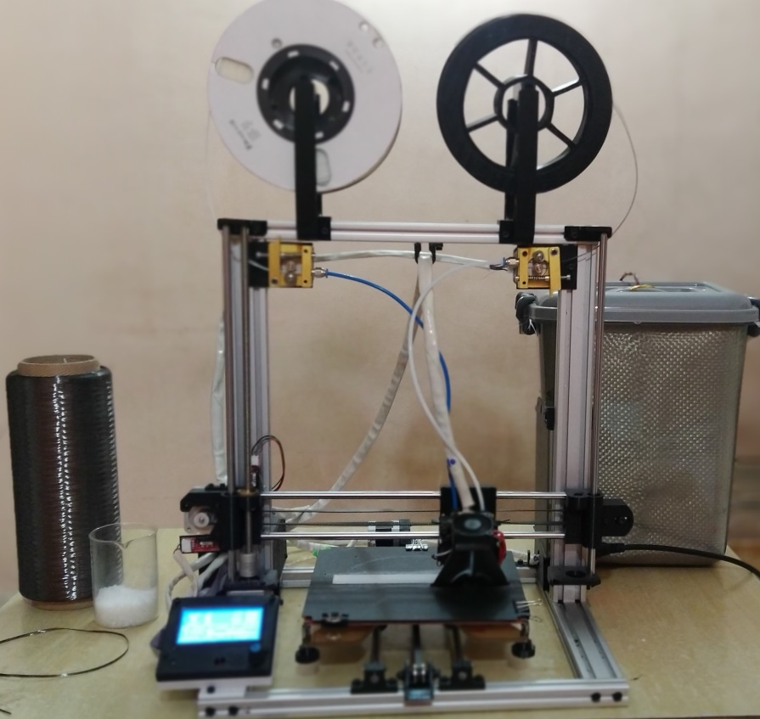
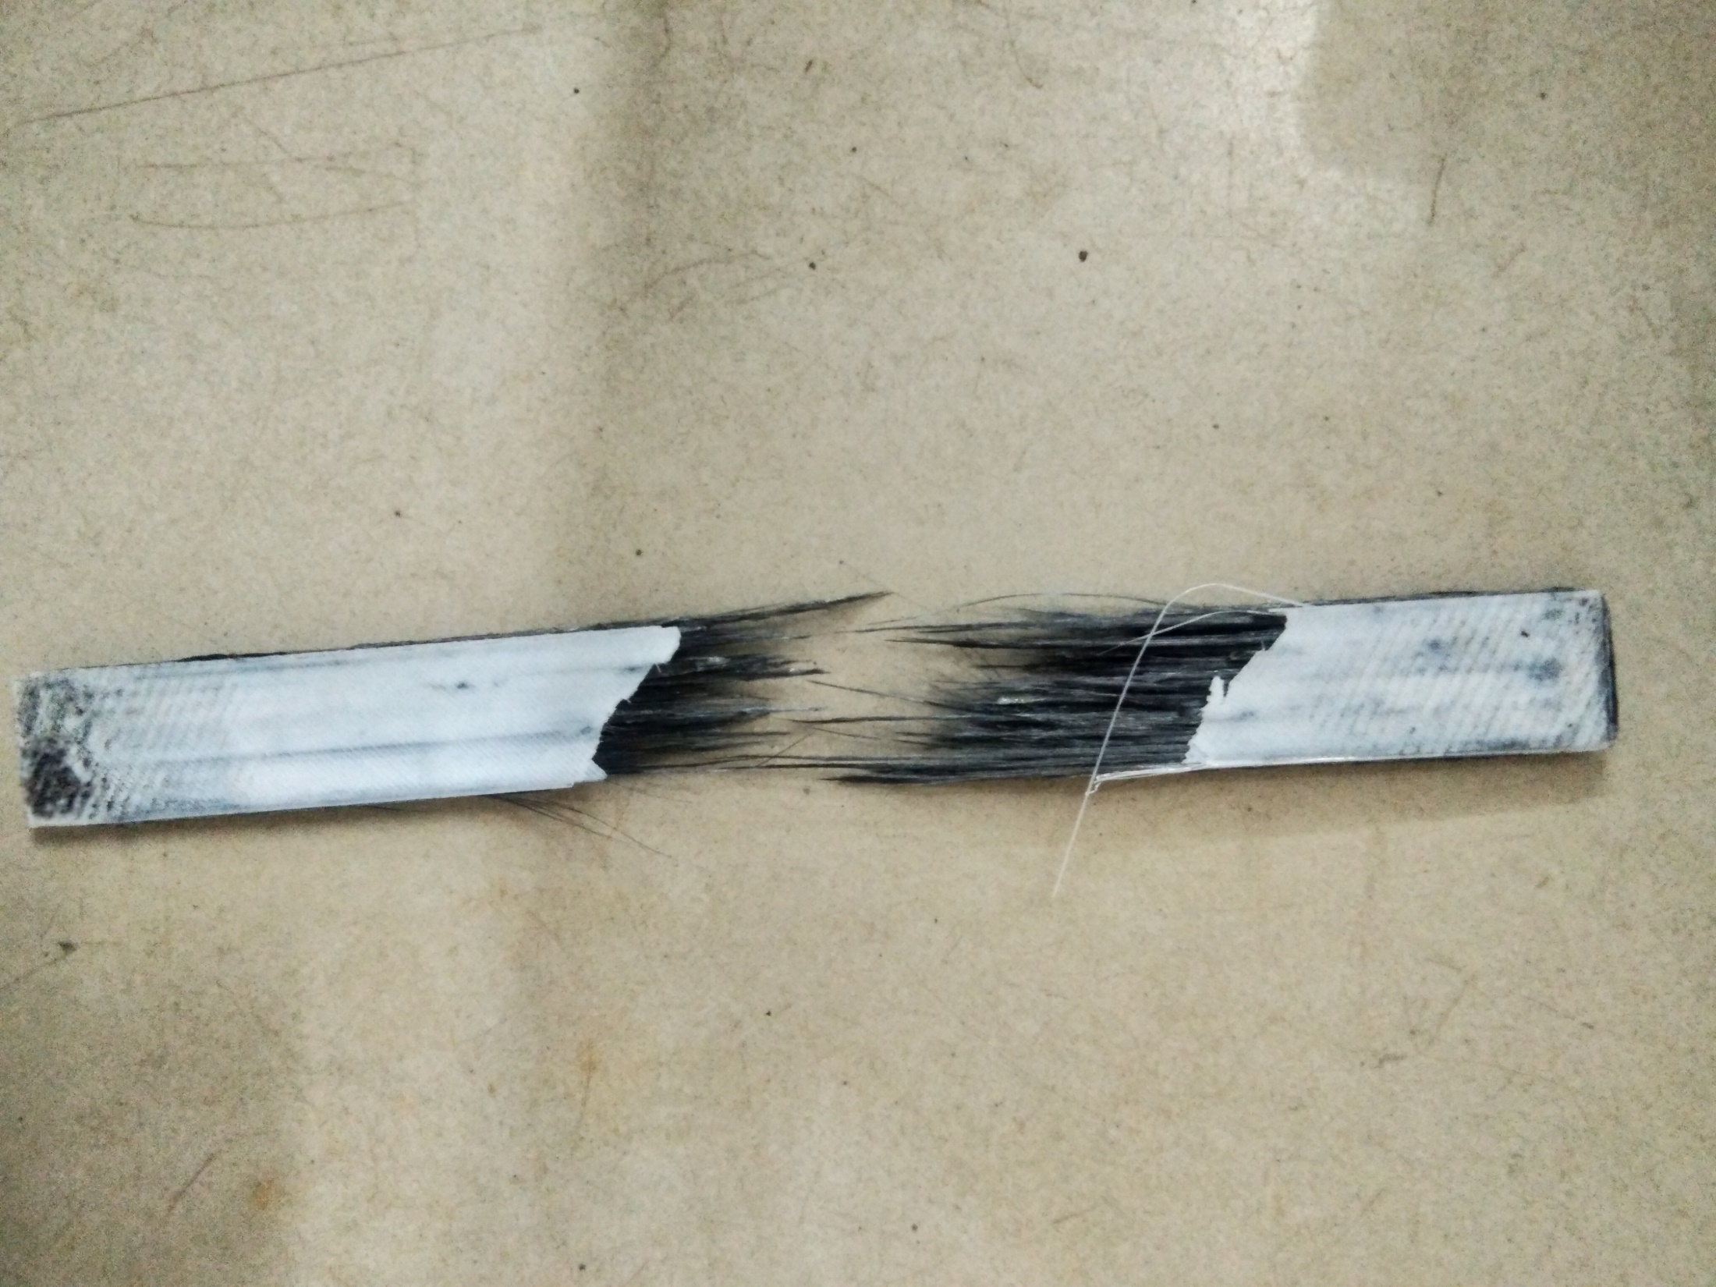
Solution
Nylon
Manufactured Filament
Carbon
fibre
Material Cost : 1400 INR per kg
Printer Cost
30,000 INR
Surface Finish
Tolerance
Specific Strength
Print Time
26 Hour/Kg
Nylon Printing On Surface
±0.1mm
Post Processable
1.4 X Mild Steel
Part Cost
3700 INR/Kg

Slide 4
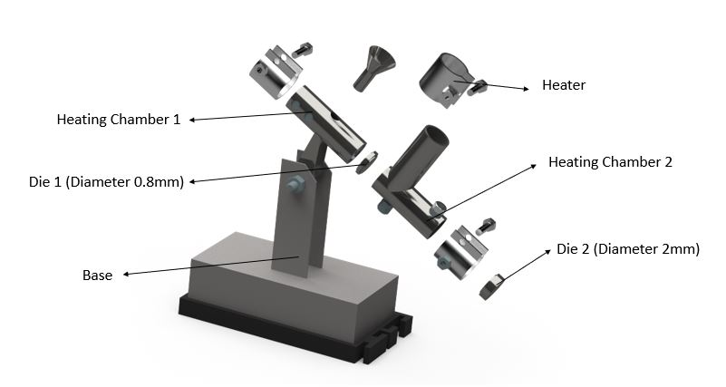
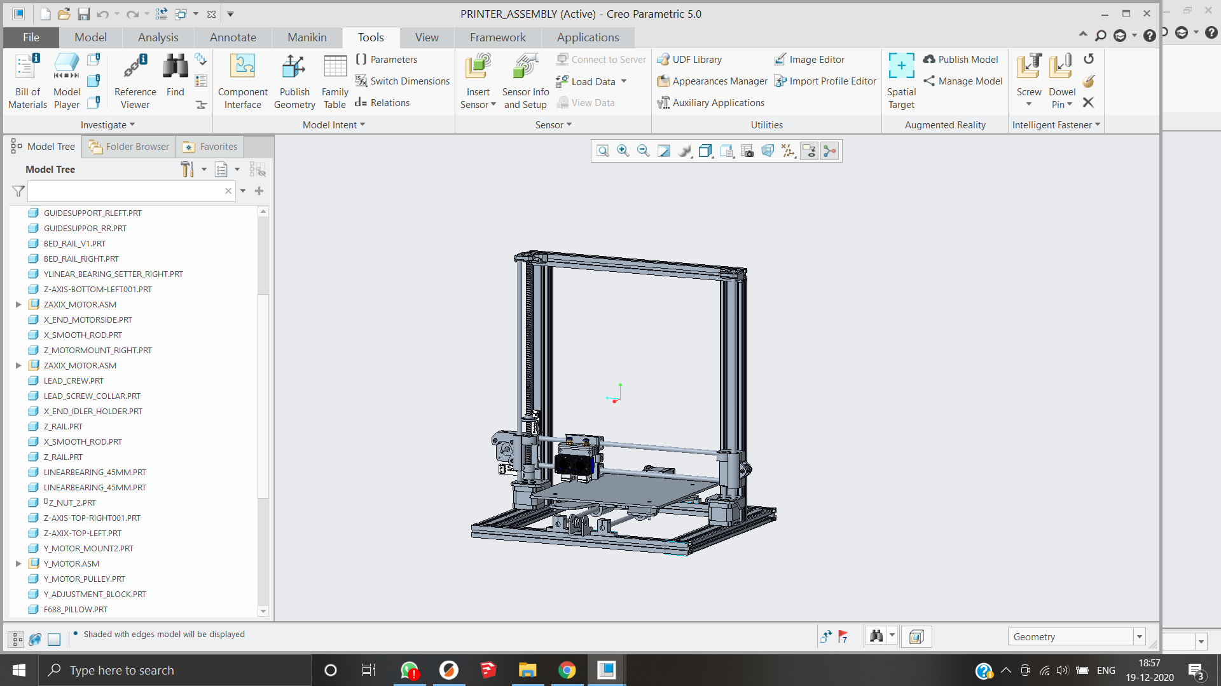
Innovation
-Manufacture parts for customers at 3500 INR /Kg.
-Technologically Readiness
-Prototype testing for first year.
Prototype development
Printing Farm Launch
1 Year
Pultrusion Dual Die system For 3K
Patent No:202121005849
2 Year
Reliable Printer development
Launch of Continuous carbon fibre 3D printer
Manufactured filament compatible 3D printer
-Sales OF the Printer
-Materials
-Printer Feedback
-Custom Programs
Sustainable by acquiring 0.2% of Indian CFRP market in 2 Years

Slide 5
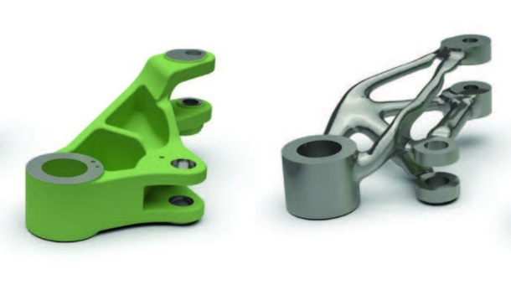


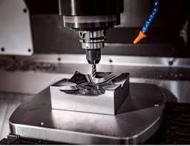

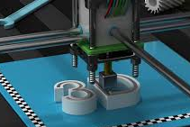
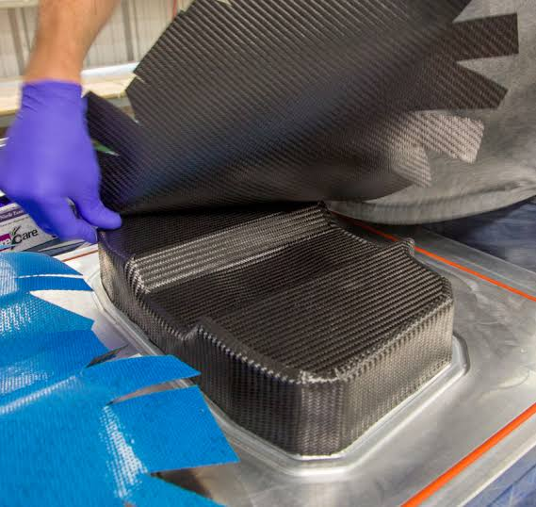

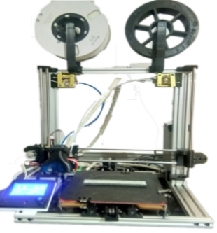
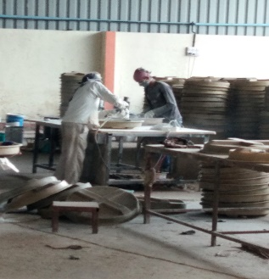

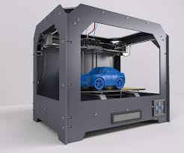
Customer Value Proposition
-Topological optimization
-30% Weight Reduction.
Subtractive manufacturing
Design
Specialized manufacturers are required
-Production Rate =26Hr/Kg
Digital library
-Moulds
-Labour
-Equipment
-Printer=35K INR
-Material=1.4K INR
-Parts Price=4/7K INR
Cost
FRP Post Processing
-Automated
-Recyclable

Slide 6
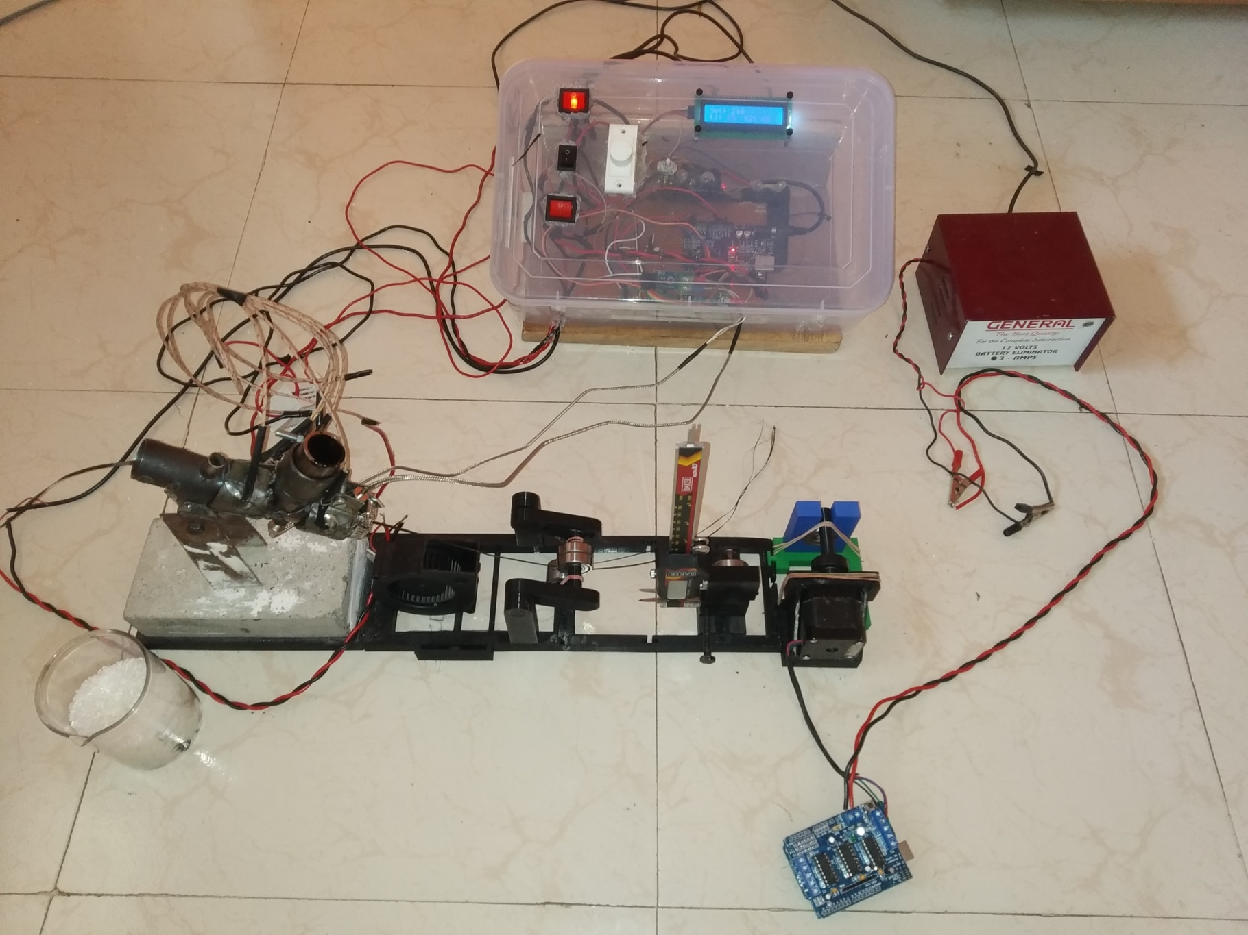
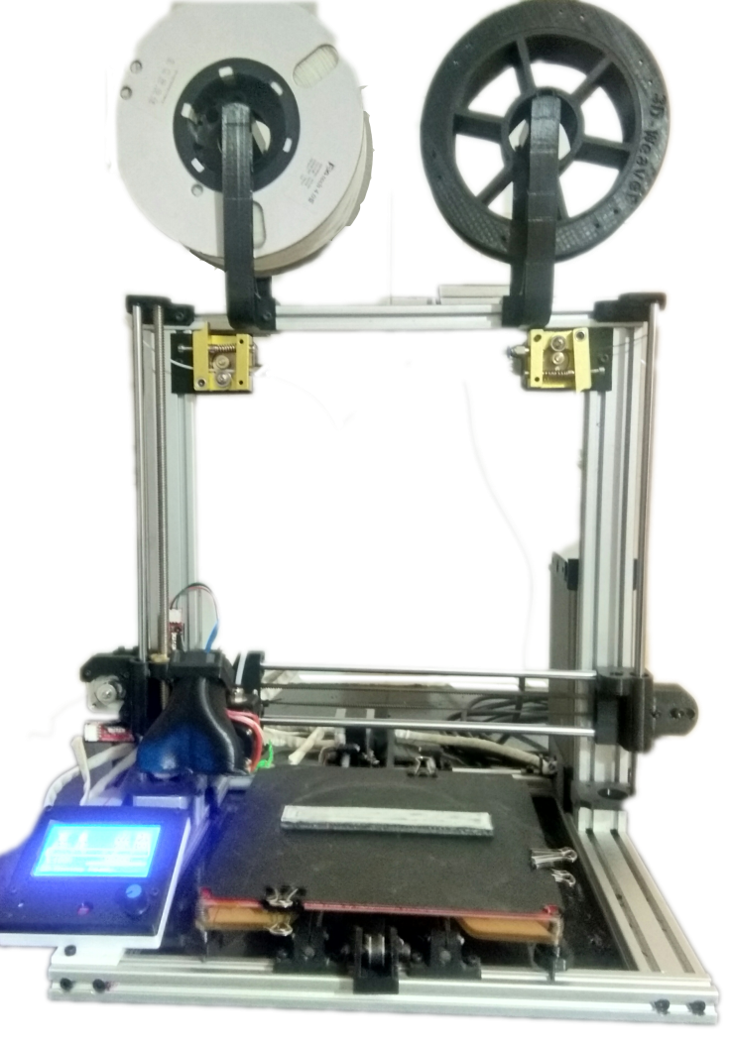
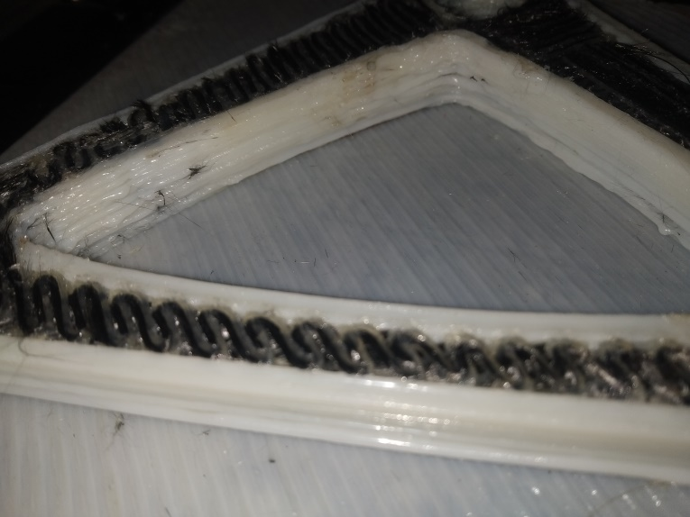
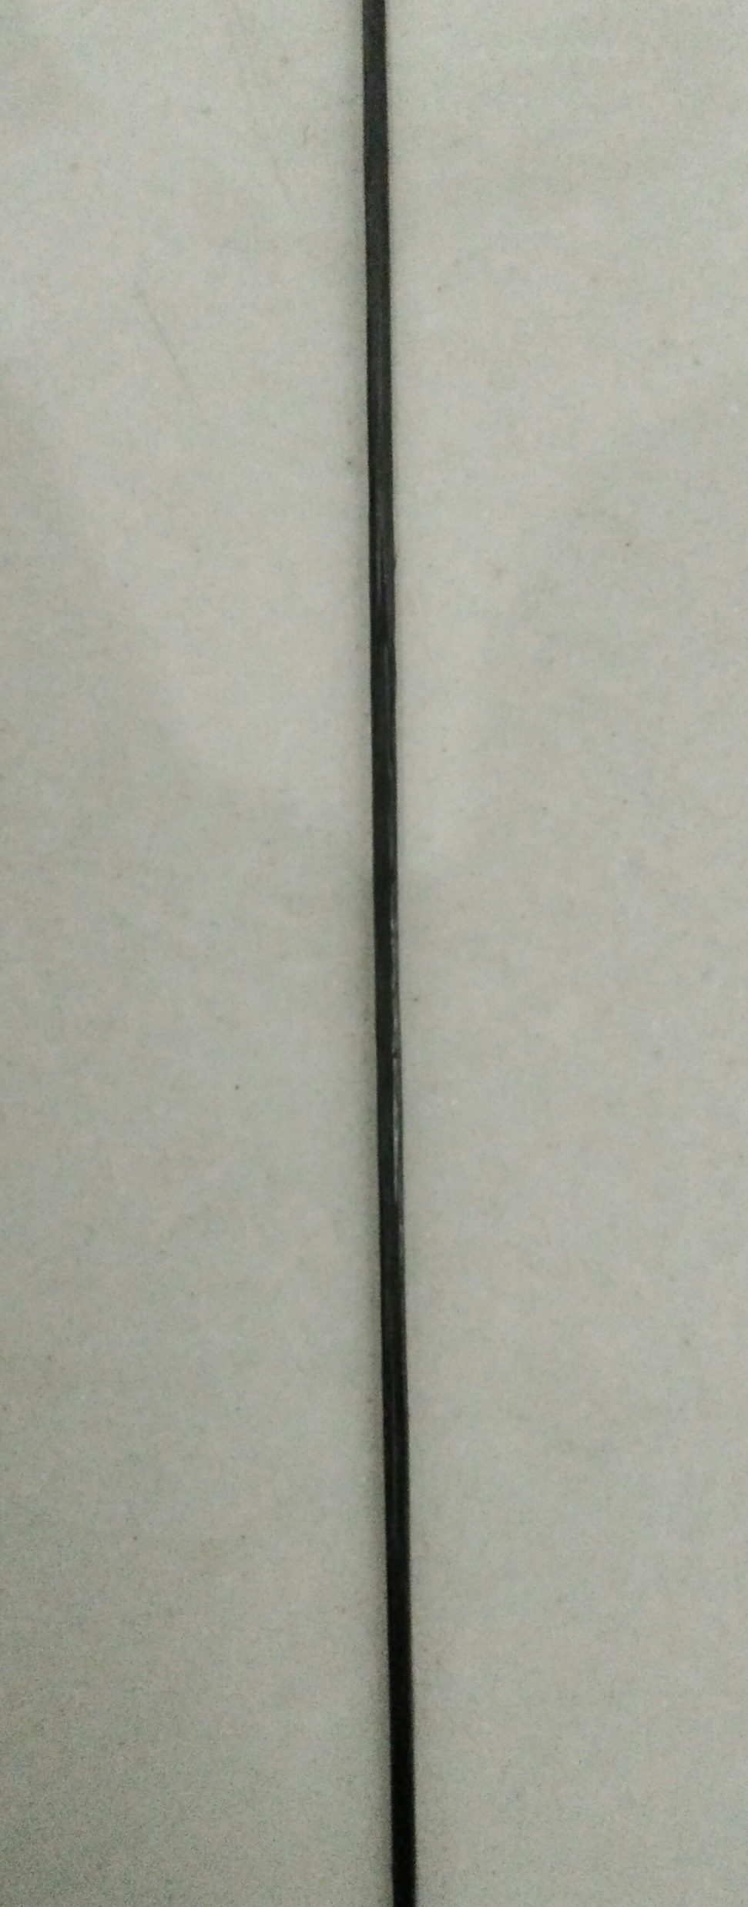
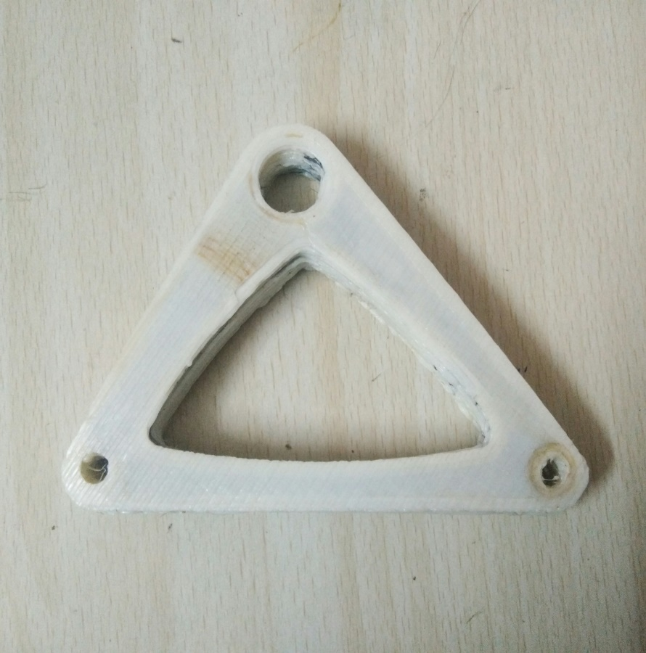

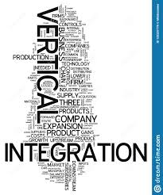

Description of your prototype
Nylon filament
Manufactured continuous fibre filament
Nylon Surface
CF
Filament
Heating Module
Temperature Controller
Pulling Mechanism
Alignment Module
Dual Nozzle
Advantages over competition
First Mover
Vertical Integration
Geographical Advantage
Low cost approach

Slide 7

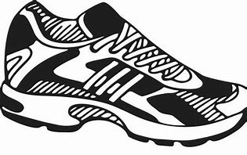





Market Potential
Obtainable Market of India 362 Cr. INR
Possible Replacement Percentage of Parts
12%
42%
5%
2%
Automotive Sector
Aerospace Sector
Sports Goods
Medical Sector
Sector
Environmental Impact
50 Tons of CO2 reduction per vehicle
1400 Tons of CO2 reduction per aircraft
Low Cost, Recyclable,
Customize Equipment
Customize Equipment According to Need
Self Sustaining Rapid Growth
World Wide
Transport

Slide 8
Current status
Current Status: TRL 5
4 To 5 Months : TRL 6
1 Year : TRL 7
Design Changes According To Feedback Of Manufacturers
Specialized Code For Common Parts
Specific Strength 1.4 X Mild Steel.
Pultrusion Setup With Production Rate 30m/Hour
Nylon Printing On Top and Bottom.
Close to Intended Performance
Improve Print Density to 1.3g/cm³
Improve Specific Strength To 2 X Mild Steel
Implement Cutting Mechanism
Pultrusion Setup for production Rate of 500m/Hour
‘National Policy for Advanced Manufacturing’.
‘Atmanirbhar Bharat’

Slide 9


